Slide 1
The Global health-wealth gap
A message to the doctors without borders
Presented by:
Hussain Ali akbar zainal
Ali Hassan Jaffar Meftah

Slide 2
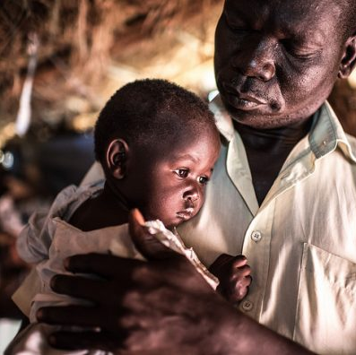
The problem
As of late, most countries have experienced a surge of GNI, which positively correlates with life expectancy. However, this is not true for a few select countries.
In this presentation, we will tackle:
Does income growth translate to longer lives?
How has the health gap evolved since 1990.
What steps can be taken to close the life expectancy gap.

Slide 3
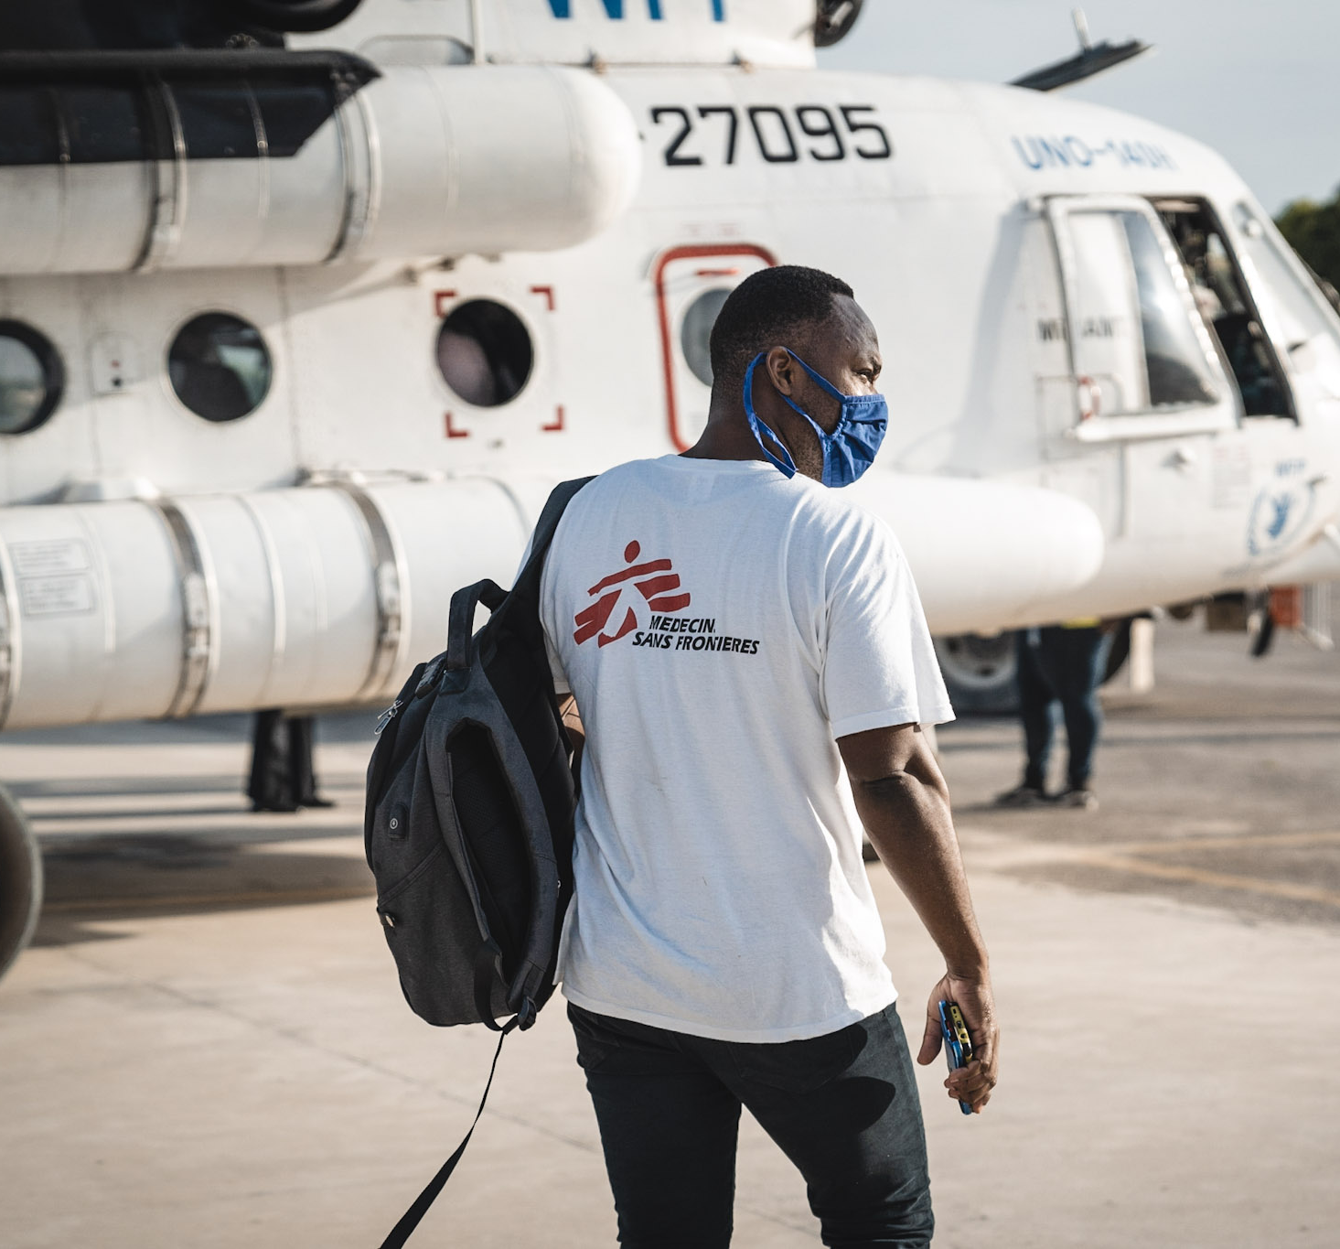
You, the audience
You are all representatives of MSF, also known as the “Doctors Without Borders”.
You provide independent, free-of-charge medical humanitarian assistance in over 75 countries.
Emergency Response
Epidemic Control
Refugee and Migrant Care
Primary Healthcare
Women & Children’s health
And much more.

Slide 4
the life expectancy divide

Slide 5
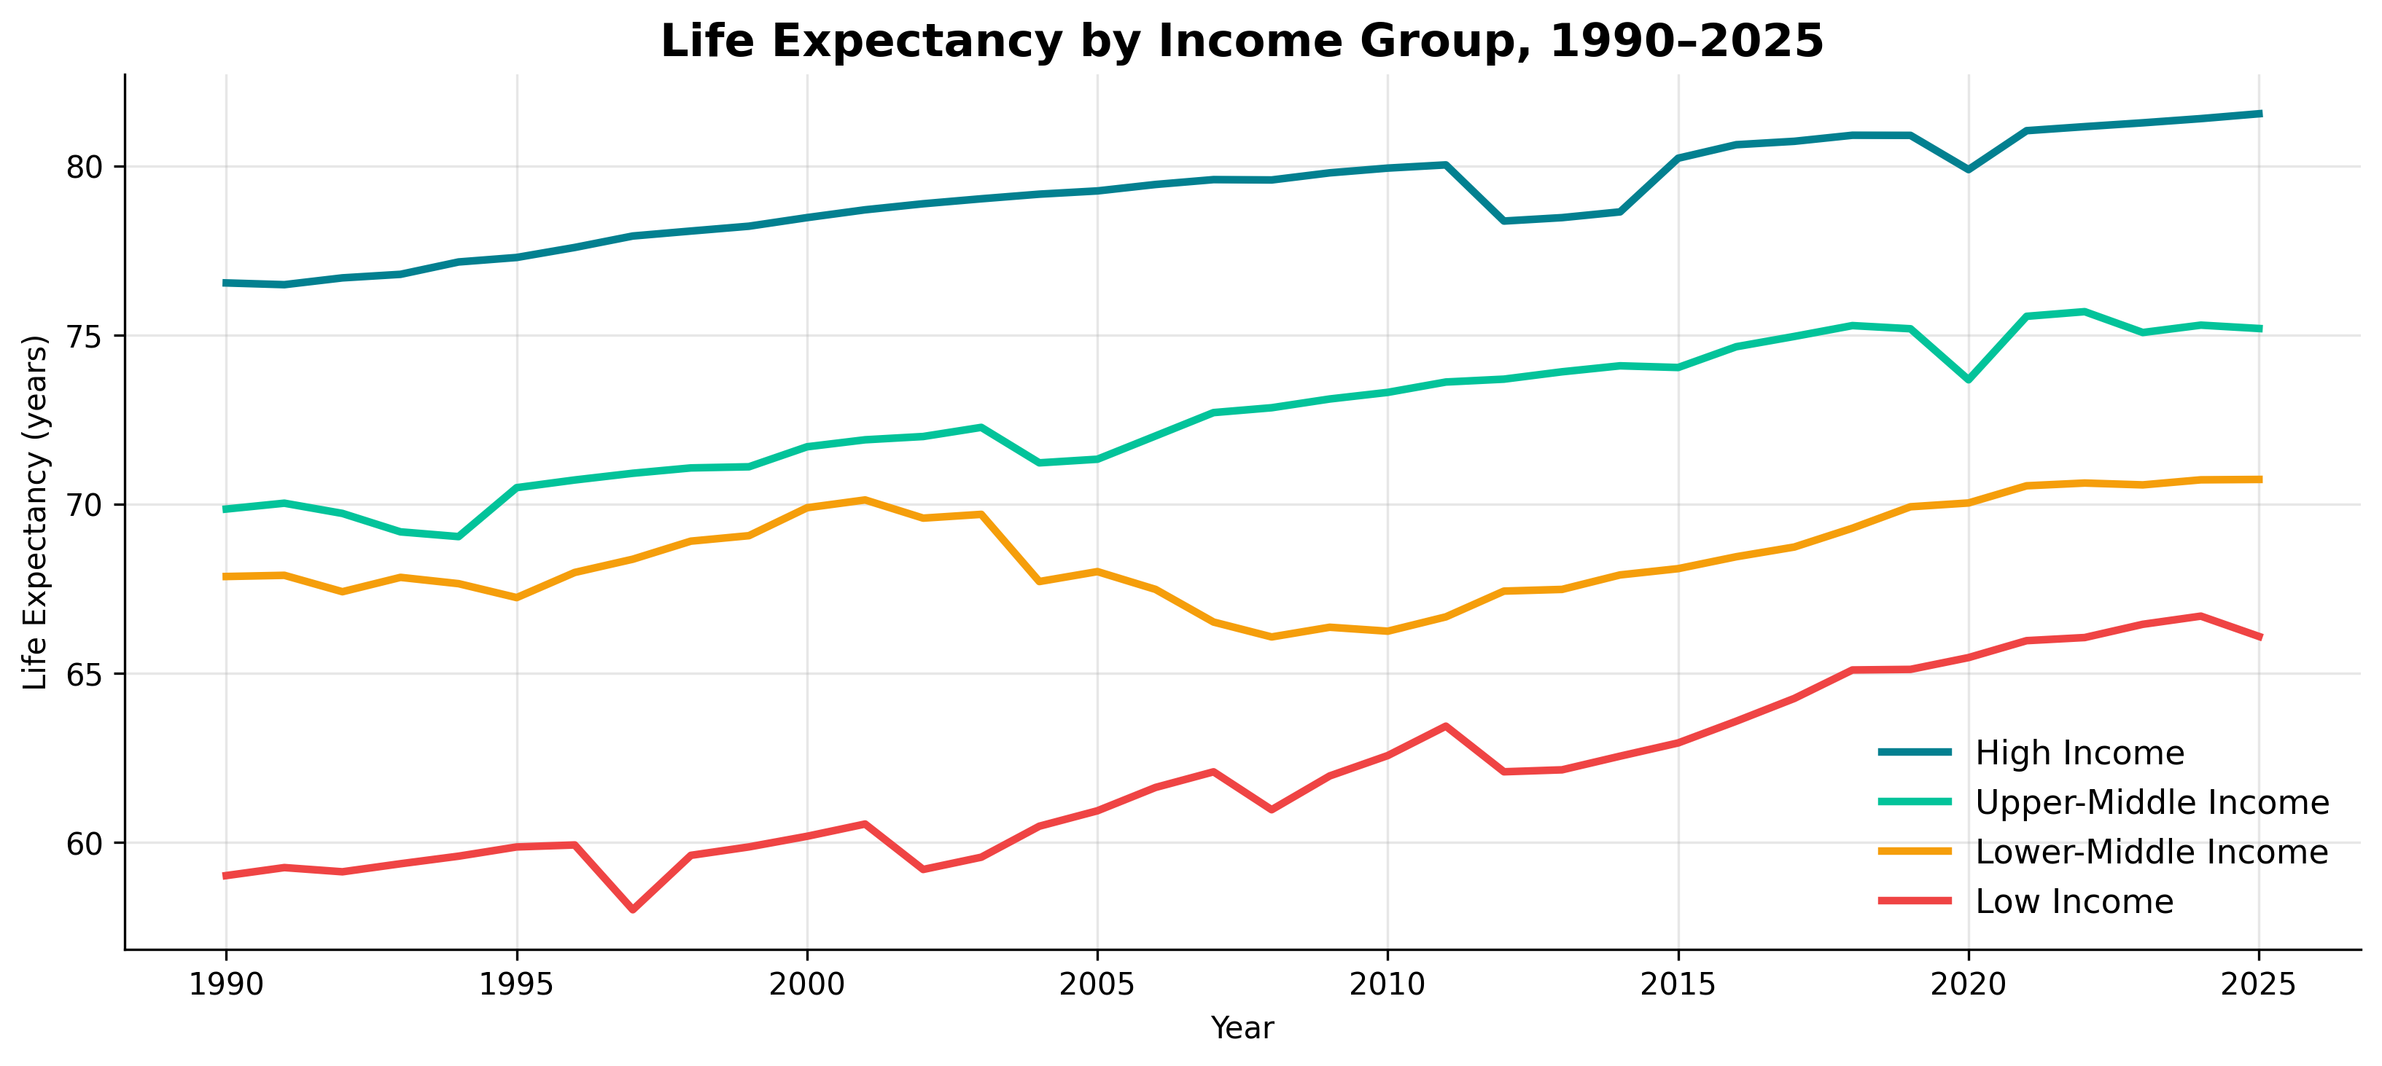
Life Expectancy by income status

Slide 6
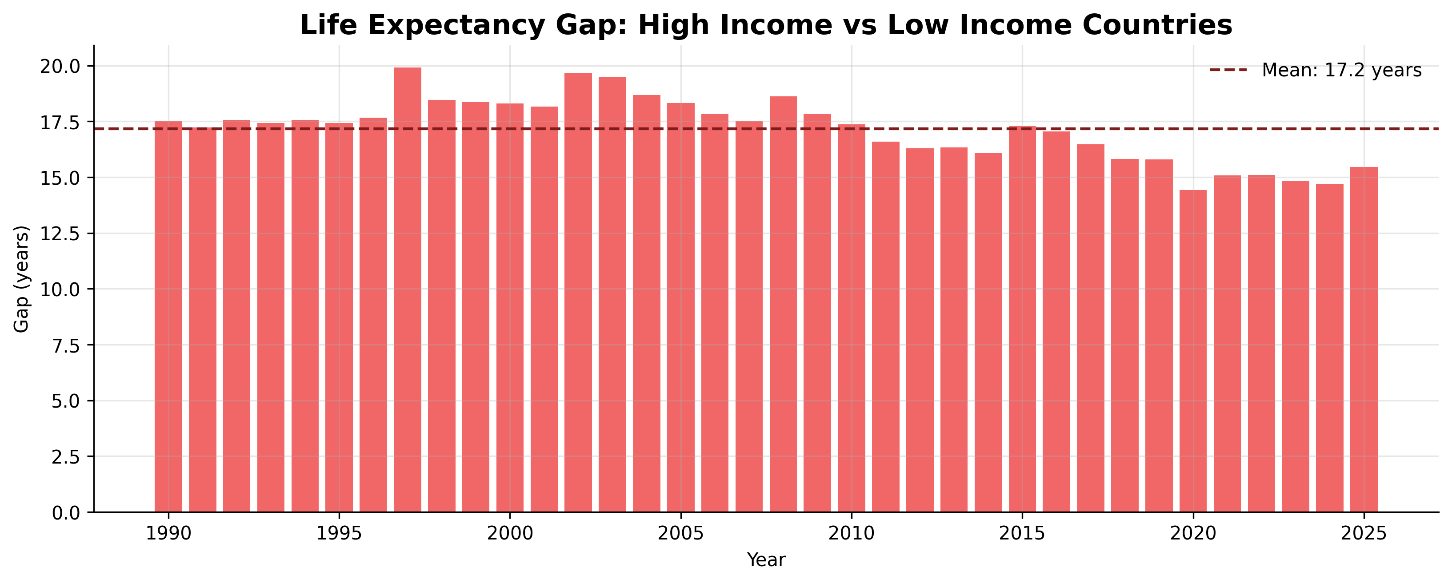
Life Expectancy gap

Slide 7
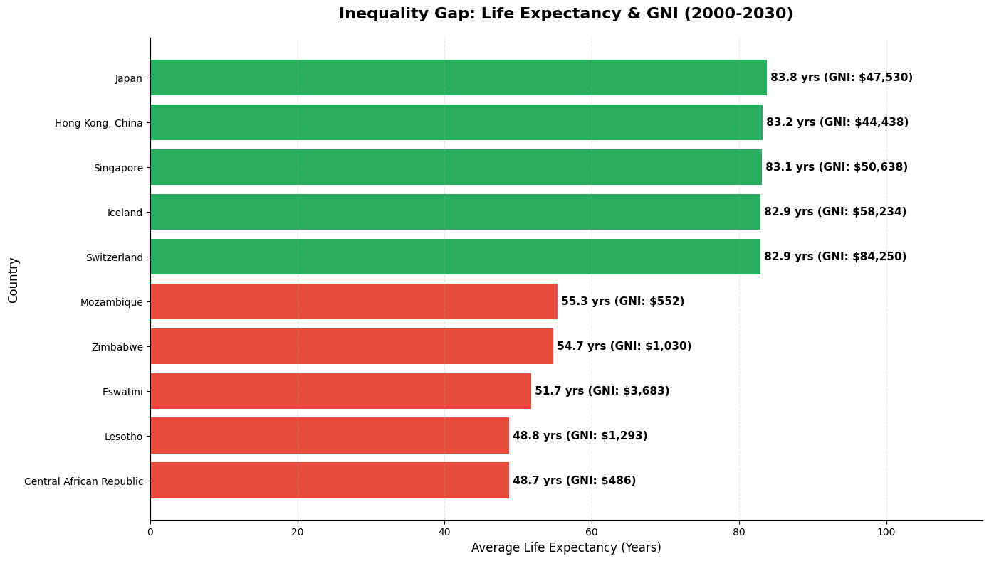
These countries are in need

Slide 8
there is some good news

Slide 9
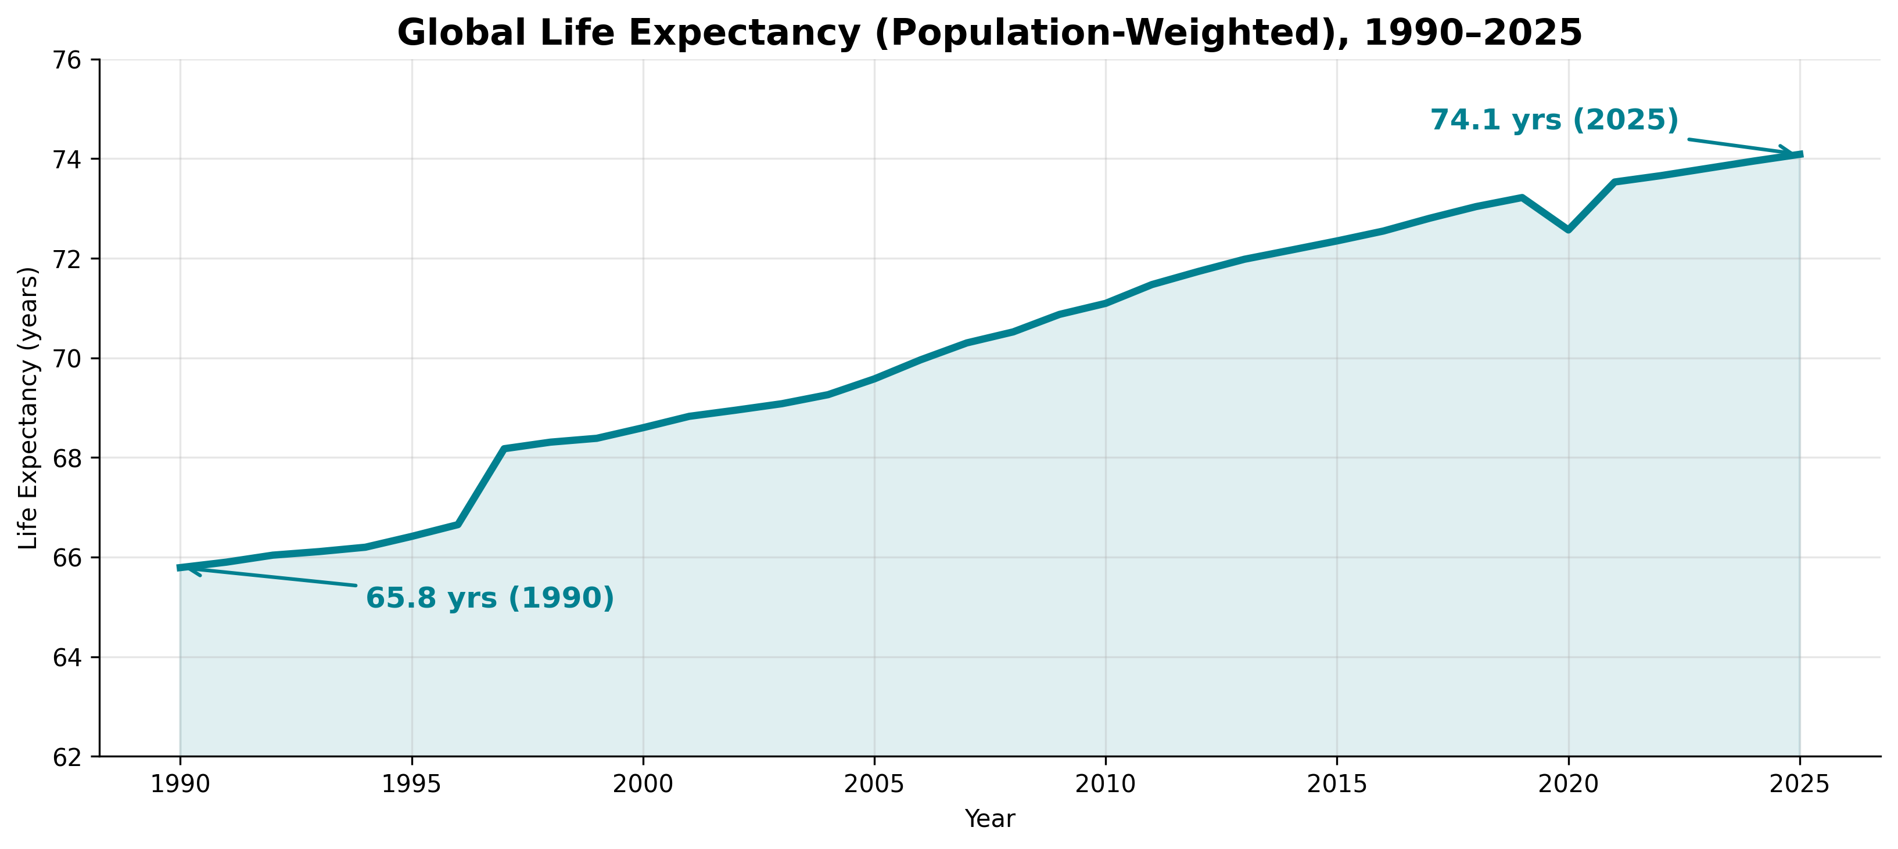
Global progress since 1990

Slide 10
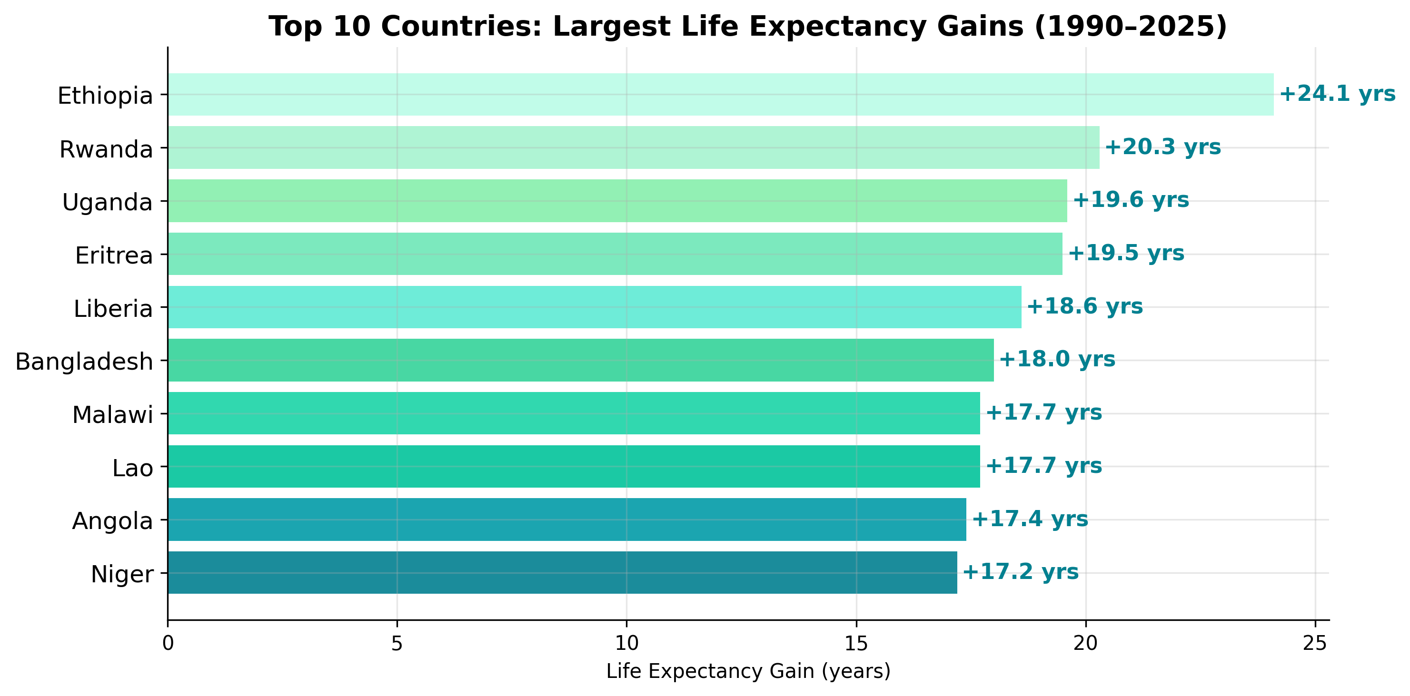
Largest Life expectancy gains

Slide 11
What caused the gap shrink?
Immunization: Expanded vaccination reduced child mortality by over 50% in lower income regions since 2000 (Gavi, 2025)
ART: The wide availability of HIV medicine (ART), decreased the death rates from HIV complications, and thus increased the life expectancy (UNAIDS Annual Report, 2025)
Conflict Resolution: Peace and stability in conflict area reduced the fatalities, allowed for healthcare development thus increased the life expectancy.

Slide 12

now it is your turn

Slide 13
Recommendations to further close the gap
Health infrastructure investment: Direct investments toward the healthcare of lowest life expectancy countries, such as the Suburban and Southern parts of Africa.
Maternal and Child Health: Prioritize reducing high mortality rates by providing skilled birth attendance and emergency neonatal care.
Economic Linkages: GNI and Life Expectancy have a 0.9 correlation. Supporting low income regions economically will increase Life Expectancy among them.
Mobile Clinics: MSF already operate mobile units that provide care across borders, you could deploy more to reach vulnerable and displaced populations.

Slide 14
Questions?

Slide 15
Sources
https://www.who.int/news/item/28-03-2025-fully-funded-gavi--the-vaccine-alliance--is-a-lifeline-for-child-survival--says-who
https://www.unaids.org/sites/default/files/2025-07/2025-global-aids-update-JC3153_en.pdf
https://www.msf.org/

